Slide 1
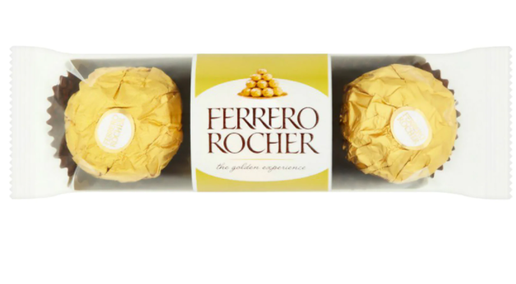
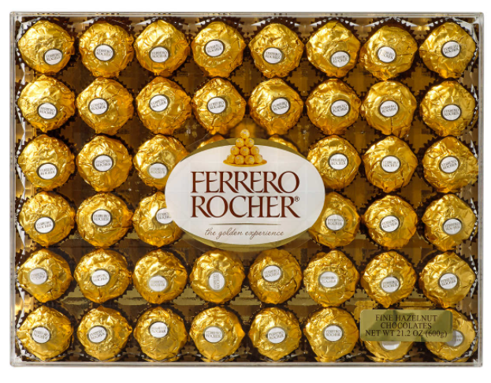
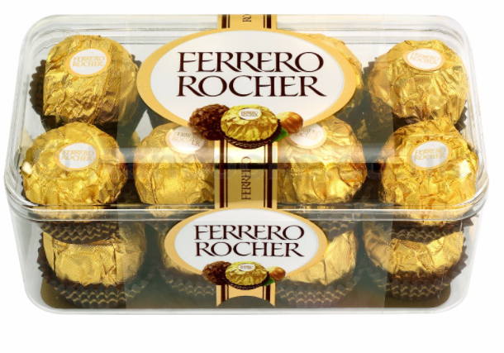
Arrays
Sumaiyah Zahid

Slide 2
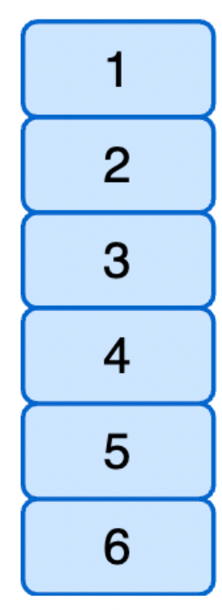
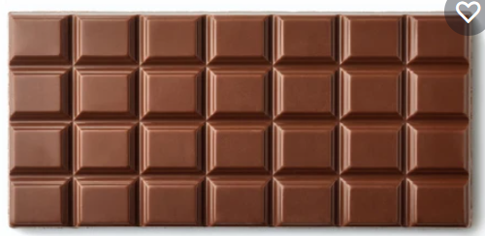
Array Definition
Consecutive memory location with same name and type just like consecutive bars of chocolates with same taste and size.

Slide 3
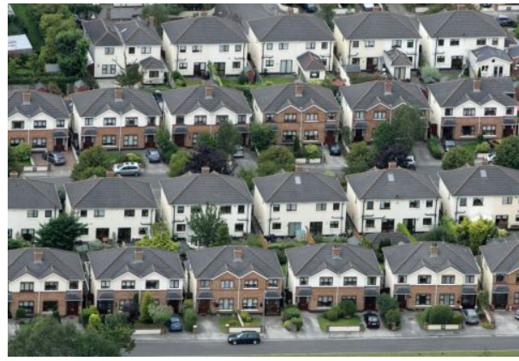
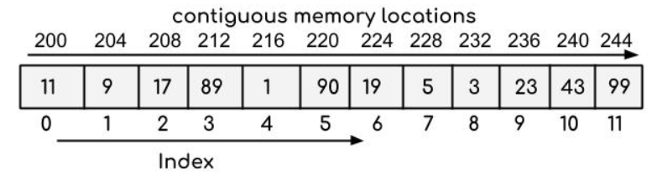
Array Definition
We have houses lanes for 80 yds, 120 yds, 240 yds etc.
Similarly we have int array , char array, float array etc.
e.g int array->

Slide 4
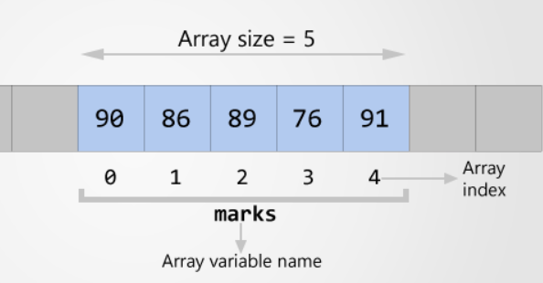
Declaration
Datatype ArrayName [NumberOfElements];
int marks[5]; // Declaration
int marks[5]={90,86,89,76,91}; //Declaration & initialization
int marks[]={90,86,89,76,91};
printf(“%d”, marks[2]);

Slide 5
Accessing Array Element
Make a c program to add all the marks into another variable sum and display the output.

Slide 6
#include <stdio.h>
int main()
{
int marks[5]={90,86,89,76,91},i,sum=0;
for(i=0; i<5; i++)
{
sum=sum + marks[i];
}
printf("%d", sum);
return 0;
}
}

Slide 7
Accessing Array Element
Make a c program to declare an array of size 5 and then take user input to initialize that array.

Slide 8
#include <stdio.h>
int main()
{
int marks[5],i;
for(i=0; i<5; i++)
{
printf("Enter number at %d location ", i);
scanf("%d",&marks[i]);
}
return 0;
}

Slide 9
Linear Search an Array
Make a c program to find the highest marks and display the output.

Slide 10
#include <stdio.h>
int main()
{
int marks[5]={90,86,89,76,91},i,high=0;
for(i=0; i<5; i++)
{
if(marks[i] > high )
{
high=marks[i];
}
}
printf("%d", high);
return 0;
}
}

Slide 11
Home Assignment
Make a c program to find the lowest marks and display the output.

Slide 12
Linear Search an Array
Make a c program to find the marks=86 and display the index of array where it exist.

Slide 13
#include <stdio.h>
int main()
{
int marks[5]={90,86,89,76,91},i;
for(i=0; i<5; i++)
{
if(marks[i] == 86 )
{
break;
}
}
printf("%d", i);
return 0;
}

Slide 14
CHAR Array
char name[30]="FAST NUCES"; //10 characters
int i;
for(i=0; i<10; i++)
{
printf("%c",name[i]); // FAST NUCES will print
}
printf("%s",name); // FAST NUCES will print

Slide 15
Home Tasks
Given a string of “Fast Nuces !(1234)”
Find out count of letter s
Find out count of capital and small letters
Find the count of special characters
Find the count of digits.
Please watch this video before coming to next lecture
https://www.youtube.com/watch?v=9I2oOAr2okY

Slide 16
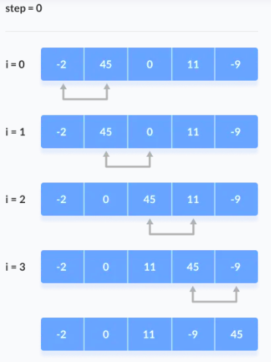
Bubble Sort

Slide 17
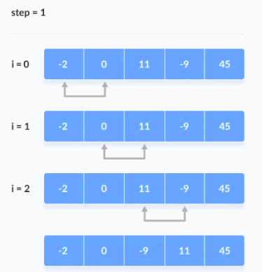
Bubble Sort

Slide 18
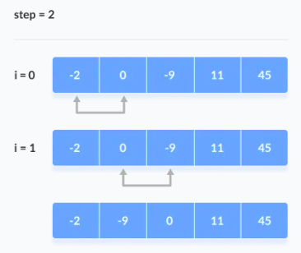
Bubble Sort

Slide 19
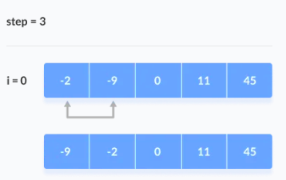
Bubble Sort

Slide 20
#include <stdio.h>
int main()
{
int data[] = {-2, 45, 0, 11, -9}, step,i;
for ( step = 0; step < 4; step++) {
for ( i = 0; i < 4 - step ; i++) {
if (data[i] > data[i + 1]) {
int temp = data[i];
data[i] = data[i + 1];
data[i + 1] = temp;
}
}
}
for ( i = 0; i < 5; i++) {
printf("%d ", data[i]);
}
return 0; }

Slide 21
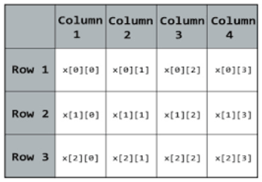
2D Array
int array [2][3];
int array [row][column];
int array[3][4] = {
{10, 11, 12, 13},
{14, 15, 16, 17},
{18, 19, 20, 21},
};

Slide 22
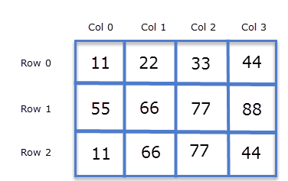
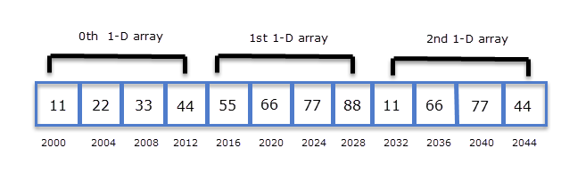
2D Array

Slide 23
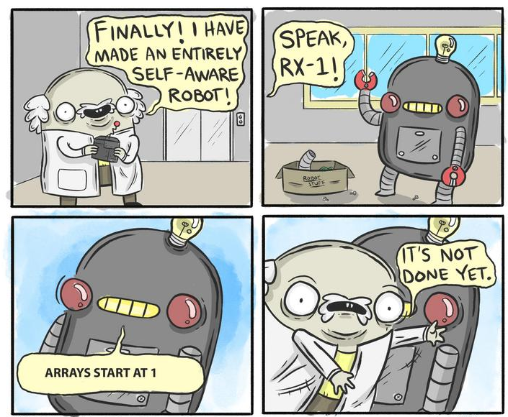
2d Array
Make a c program to declare a 2D-array of 3 rows and 4 columns and then take user input to initialize that array.

Slide 24
#include <stdio.h>
int main()
{
int array[3][4], i,j;
for(i=0; i<3; i++)
{
for(j=0; j<4; j++)
{
scanf("%d", &array[i][j]);
}
}
return 0;
}

Slide 25
2d Array
Make a c program to add two matrix and store there result in 3rd matrix.

Slide 26
#include <stdio.h>
int main()
{
int array1[3][4] = {
{10, 11, 12, 13},
{14, 15, 16, 17},
{18, 19, 20, 21} };
int array2[3][4] = {
{10, 11, 12, 13},
{14, 15, 16, 17},
{18, 19, 20, 21} };
int array3[3][4],i,j;

Slide 27
for(i=0; i<3; i++)
{
for(j=0; j<4; j++)
{
array3[i][j]=array1[i][j] + array2[i][j];
}
}
for(i=0; i<3; i++)
{
for(j=0; j<4; j++)
{
printf("%d ",array3[i][j]);
}
printf("\n");
}
return 0;
}

Slide 28
Home Assignment
Make a c program to multiply two matrix and store there result in 3rd matrix.
Make a c program to transpose a matrix.

Slide 29
Arrays Practice Problem
Write a Program to check whether a given matrix is an identity matrix or not.
Write a Program to find whether the given is the matrix is diagonal or not.
Write a Program to display an upper triangular matrix.
Write a Program to check whether a matrix is symmetric or not.
Write a Program to find the sum of an upper triangular matrix.
Write a Program to find the maximum element in the 2D matrix.
Write a Program to find the position of an element in a 2d array or Matrix.
https://www.examveda.com/c-program/practice-mcq-question-on-arrays-and-strings/

Slide 30
Multi-Dimensional Array
int Ferrero [2][2][4];
int array [z][x][y];
int array[2][3][4] ;
{
{ {0,1,2,3}, {4,5,6,7}, {8,9,10,11} },
{ {12,13,14,15}, {16,17,18,19}, {20,21,22,23} }
};

Slide 31
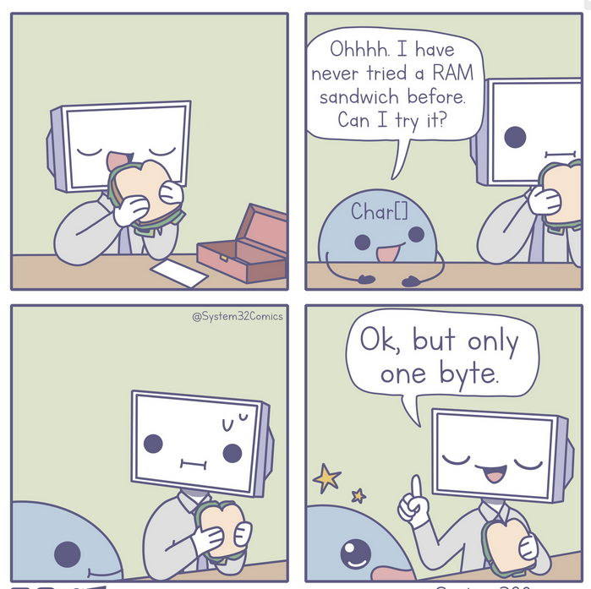
STRINGS

Slide 32
String \ CHAR array
char name[]={‘F’,’A’,’S’,’T’,’ ‘ ,’N’, ‘U’, ‘\0’};
char name[]="FAST NU";
\0 = Null character or String Terminator
for(i=0; i<10; i++)
{ printf("%c",name[i]);}

Slide 33
String
#include <stdio.h>
int main()
{
char name[20];
scanf("%s", name); // No need of &name
printf("Your name is %s", name);
return 0; // Array name alone works as a base address
}

Slide 34
Gets and Puts
#include <stdio.h>
int main()
{
char name[20];
puts("Enter your name");
gets(name);
puts(name);
return 0;
}

Slide 35
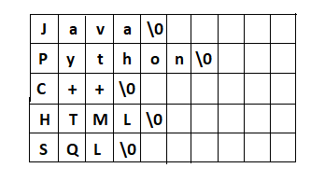
2D Strings
char language[5][10] =
{
{'J','a','v','a','\0'}, {'P','y','t','h','o','n','\0'},
{'C','+','+','\0'}, {'H','T','M','L','\0'},
{'S','Q','L','\0'} };
char language[5][10] = {"Java", "Python", "C++", "HTML", "SQL"};

Slide 36
2D Strings
// it is valid
char language[ ][10] = {"Java", "Python", "C++", "HTML", "SQL"};
// invalid
char language[ ][ ] = {"Java", "Python", "C++", "HTML", "SQL"};
// invalid
char language[5][ ] = {"Java", "Python", "C++", "HTML", "SQL"};

Slide 37
#include <stdio.h>
int main()
{ int i;
char language[5][10] = {"Java", "Python", "C++", "HTML", "SQL"};
for(i=0; i<5; i++)
printf("%s\n", language[i]);
return 0;
}

Slide 38
#include <stdio.h>
int main()
{ int i;
char name[5][10];
for(i=0; i<5; i++)
scanf("%s", name[i]);
for(i=0; i<5; i++)
printf("%s\n", name[i]);
return 0;
}

Slide 39
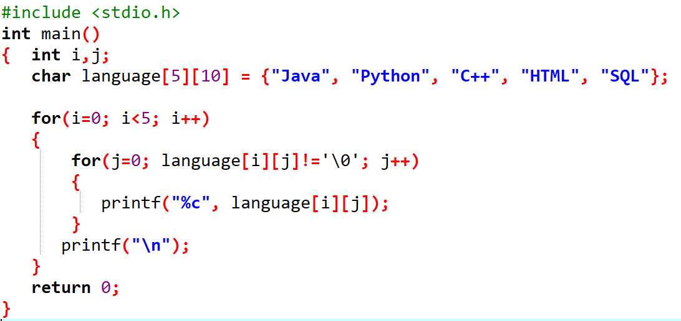

Slide 40
HOME ASSIGNMENT
Write a program to change the case of all the alphabets in an array of strings.
Write a program that counts the no. of upper and lower case letters in an array of strings

Slide 41
String.h ------> strlen
size_t strlen(const char *str);
Computes the length of the string str up to but not including the terminating null character.
Returns the number of characters in the string.

Slide 42
String.h ------> strcmp
int strcmp(const char *str1, const char *str2)
It compares the two strings and returns an integer value.
If Return value < 0 then it indicates str1 is less than str2.
If Return value > 0 then it indicates str2 is less than str1.
If Return value = 0 then it indicates str1 is equal to str2.

Slide 43
String.h ------> strncmp
int strncmp(const char *str1, const char *str2, size_t n)
It compares both the string till n characters or in other words it compares first n characters of both the strings.

Slide 44
#include <stdio.h>
#include<string.h>
int main()
{
char name1[20]="FAST";
char name2[20]= "NUCES";
printf("Length of string is %d and %d \n", strlen(name1), strlen(name2));
int i=strcmp(name1, "FAST");
int j=strcmp(name1, name2);
printf("Comparison result is %d %d", i,j);
return 0;
}

Slide 45
String.h ------> strcat
char *strcat(char *str1, char *str2)
It concatenates two strings and returns the combined string.

Slide 46
String.h ------> strncat
char *strncat(char *str1, char *str2, int n)
It concatenates n characters of str2 to string str1.

Slide 47
String.h ------> strcpy
char *strcpy(char *str1, char *str2)
It copies the string str2 into string str1, including the end character (terminator char ‘\0’).

Slide 48
String.h ------> strncpy
char *strncpy(char *str1, char *str2, int n)
It copies the n characters of str2 into string str1.

Slide 49
Try These
strcat(str1, str2)
strncat(str1,str2, 5)
strcpy(str1,str2)
strncpy(str1,str2,5)

Slide 50
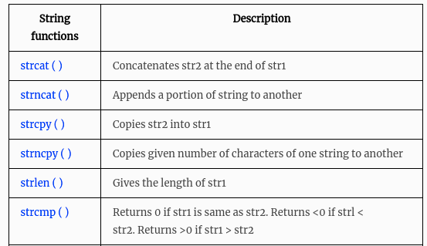
https://fresh2refresh.com/c-programming/c-strings/

Slide 51
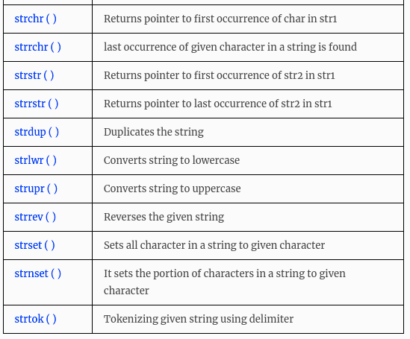
https://fresh2refresh.com/c-programming/c-strings/

Slide 52
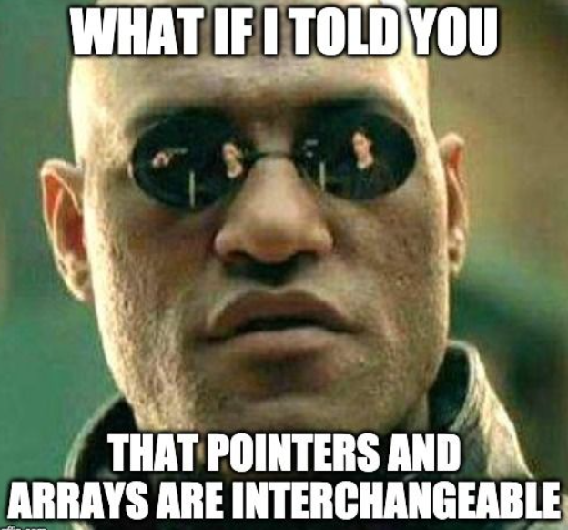
Arrays As a Pointers
int marks[]={90,86,89,76,91};
printf(“%d”, marks[2]);
printf(“%d”, marks); ????
Array name holds the starting address of that array i.e.
marks = & (marks[0])
Arrays are not variables, but pointer-variable.

Slide 53
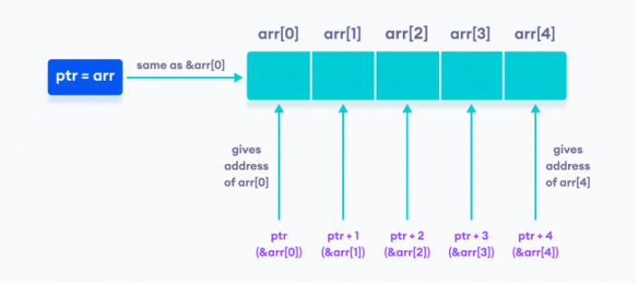
Arrays As a Pointers
int arr[]={90,86,89,76,91};
int *ptr=arr;
ptr = arr
arr = &arr[0]
arr[0] = *(arr +0) or *(ptr +0) // Array indexing is actually
arr[1] = *(arr +1) or *(ptr +1) //dereferencing memory location
arr[i] = *(arr +i) or *(ptr +i) //with pointer addition

Slide 54
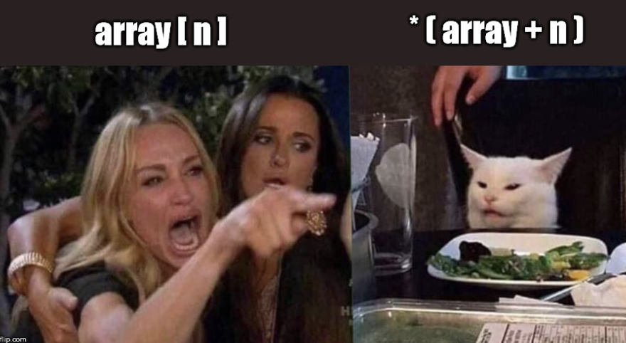
Arrays As a Pointers
#include <stdio.h>
int main()
{
int num[ ] = { 24, 34, 12, 44, 56, 17 } ;
int i, *j ;
j = num;
for ( i = 0 ; i <= 5 ; i++ )
{
printf ( "\naddress = %u ", j ) ;
printf ( "element = %d", *j ) ;
j++ ; /* increment pointer to point to next location */
}
}

Slide 55
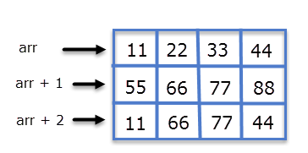
2D Array
https://overiq.com/c-programming-101/pointers-and-2-d-arrays/

Slide 56
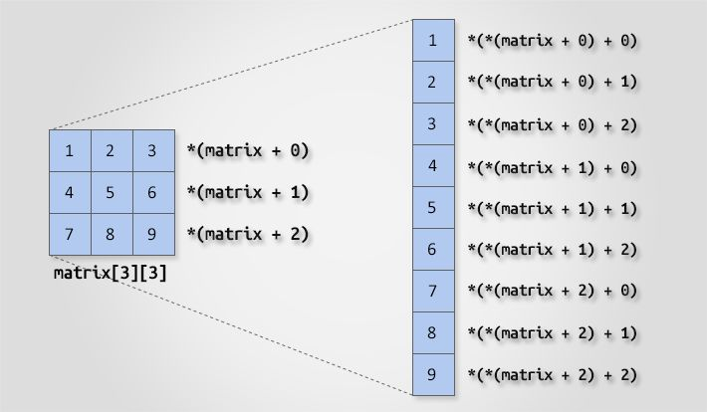
2D Arrays As a Pointers

Slide 57
Home Assignment
Make a c program to print 2D matrix using pointers.

Slide 58
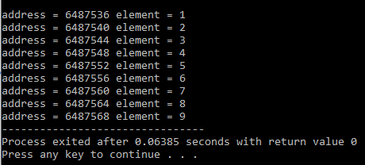
2D Arrays As a Pointers
#include <stdio.h>
int main()
{
int num[3][3] = { {1,2,3},{4,5,6},{7,8,9}} ;
int i, j;
for ( i = 0 ; i < 3 ; i++ )
{
for(j=0; j<3; j++)
{
printf ( "\naddress = %u ", *(num + i)+j ) ;
printf ( "element = %d", *(*(num + i)+j) ) ;
}
}
}

Slide 59
Arrays Practice Problem
Write a program that calculates the sum of all the elements in 1D and 2D array using pointers.
Write a program that finds the highest number in a float type array of 20 elements using pointer.

Slide 60
Strings As a Pointers
char name[ ] = "FAST" ;
char *ptr ;
ptr = name ; /* store base address of string */
while ( *ptr != `\0' )
{
printf ( "%c", *ptr ) ;
ptr++ ;
}

Slide 61
Strings As a Pointers
char str[ ] = "Hello" ;
char *p = "Hello" ;
We cannot assign a string to another, whereas, we can assign a char pointer to another char pointer.
Once a string has been defined it cannot be initialized to another set of characters. Unlike strings, such an operation is perfectly valid with char pointers.

Slide 62
Strings As a Pointers
char str1[ ] = "Hello" ;
char str2[10] ;
char *s = "Good Morning" ;
char *q ;
str2 = str1 ; /* error */
q = s ; /* works */
_____________________________
char str1[ ] = "Hello" ;
char *p = "Hello" ;
str1 = "Bye" ; /* error */
p = "Bye" ; /* works */

